Slide 1
Cricket Winner Prediction
Nitin Prakash

Slide 2
Introduction - Cricket
With over 3.0 billion estimated fans all over the world, Cricket is the most popular sport after Soccer.
The three most popular formats of Cricket are Test match, One Day International (ODI) and T20 (20-20).
2019 is ODI World Cup season. World Cup is every 4 years, this time hosted by England and Wales.

Slide 3
Introduction - Cricket
Two teams play a match. Each team gets 1 innings (turn) to bat, while the other team fields.
Captains of both teams meet for a coin toss in order to decide who bats first or fields first.
Each team has 11 players who bat, bowl and field. Specialist batsmen, specialist ballers and a wicketkeeper (similar to ‘catcher’ in baseball).
Inning ends when 10 players are ‘out’ or 300 deliveries have been balled by the fielding team. Team with most runs wins the match.
Example: Team 1 bats first and makes 250 runs, Team 2 bats second and makes only 240 runs. Margin of victory is 10 runs.
Team 1 bats first and makes 200 runs, Team 2 bats second and makes 201 runs and only 3 batsmen are out. Margin of victory is 7 wickets (10 – 3)

Slide 4
Introduction - Cricket
ODI cricket has both controllable and uncontrollable variables.
Venue, game type (day-only or day-night) and coin-toss result are the main uncontrollable variables in the ODI format.
Project:
Attempting to build a logistic regression model to predict the outcome of a cricket match.

Slide 5
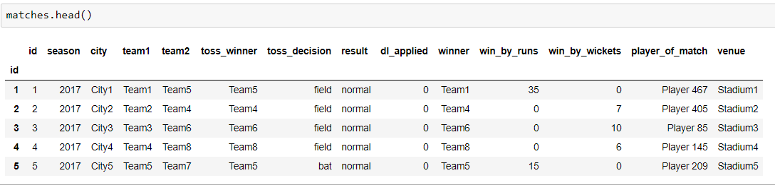
Data
Data was downloaded from www.cricsheets.org and www.espncricinfo.com
Matches dataset contains variables like match_season, venue, team1, team2, toss_winner, toss_decision, result, dl_applied, winner, win_by_runs, win_by_wickets, player_of_match were considered for matches played since Jan 1, 2000
Deliveries dataset contains ball-by-ball outcome for each over: match_id, inning, batting_team, bowling_team, over, ball, batsman, non_striker, bowler, is_super_over, wide_runs, bye_runs, legbye_runs, noball_runs, penalty_runs, batsman_runs, extra_runs, total_runs, player_dismissed, dismissal_kind, fielder

Slide 6
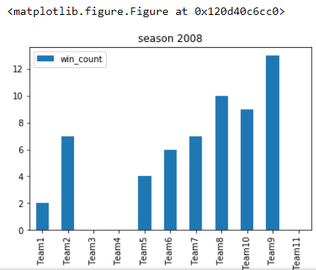
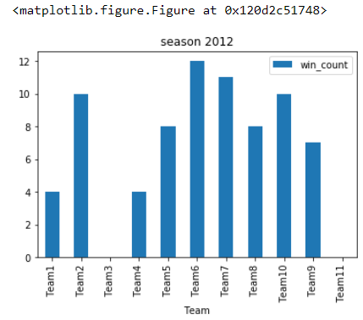
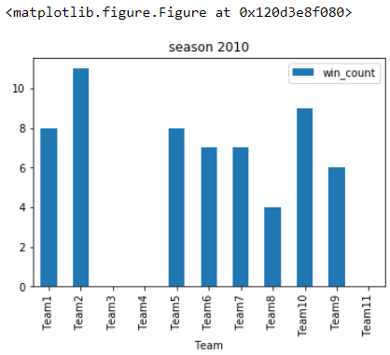
Features – Season (year), Coin toss, Venue
Time is an important feature for predicting match outcome.
Team performance varies per season and hence is an important variable in the prediction model.
In this dataset season feature acts as the time period of every match.

Slide 7
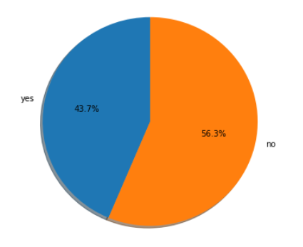
Features – Season (year), Coin toss, Venue
Coin toss - 43.7% of toss winners are also match winners.
Toss winning also acts as a major feature in predicting the result.
Venue: home condition plays a very important role in predicting match winners.

Slide 8
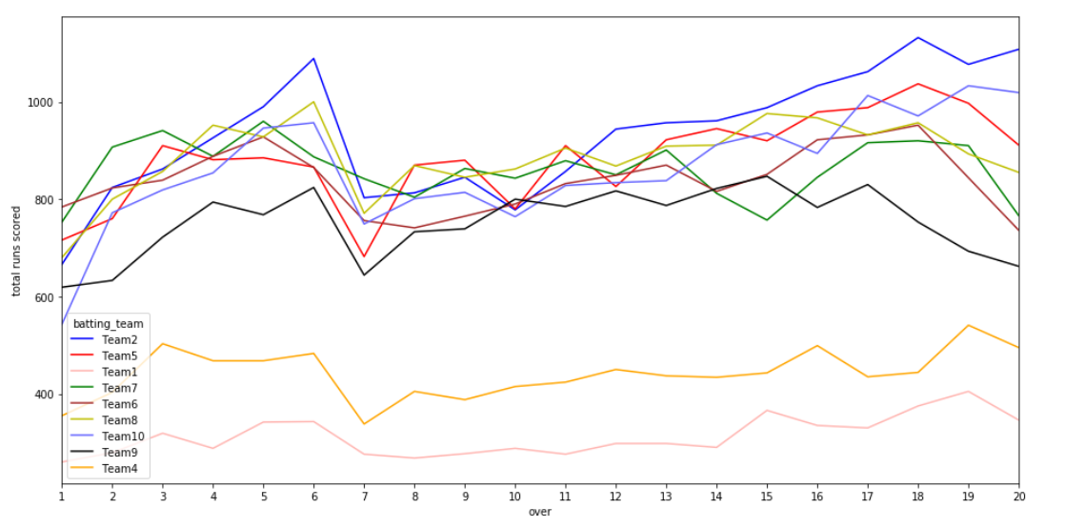
Features – Team performance
Need to come up with measurements for team performance.
Let us look at the runs scored per over across all matches. 1 over = 6 deliveries (pitches)
This isn’t very useful so let us compute team batting and team balling averages

Slide 9
Features – Team performance
The team performance measurements are calculated using the Deliveries dataset
Team_A_batting_average, Team_B_batting_average: Computed using bye_runs, legbye_runs, batsman_runs
Team_A_bowling_average, Team_B_bowling_average: Computed using wide_runs, noball_runs, penalty_runs, extra_runs, total_runs
Team_A_total_runs, Team_B_total_runs

Slide 10
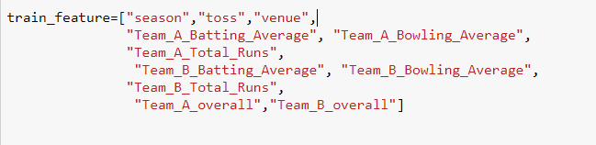
Features:
Target variable:
‘winner’ is our dependant variable and takes values 0 and 1.
Test…train:

Slide 11
Logistic Regression
Logistic regression is generally preferred when there are only two categories of the dependent variable.
Logistic regression fits an S-shaped curve to the data.
This curve relationship ensures that:
The predicted values are always between 0 and 1, and that the predicted values correspond to the probability of Y being 1 (win) or 0 (lose).

Slide 12
Logistic Regression
Assume that team ‘a’ plays a match against the team ‘b’ for the k^{th} time and let p_{abk} be the probability of team ‘a’ winning that match. Then the win-loss odds ratio of that match is:
logit(p_{abk}) = p_{abk} / (1−p_{abk})
Accordingly, the outcomes of such bilateral matches can be modeled by the following logistic regression model:
Ln(p_{abk} / (1 – p_{abk})) = β₀ + β₁TBat_{a} + β₂TBowl_{a} + β₃TRuns_{a} + β₄TOvr_{a} + β₅TBat_{b} + β₆TBowl_{b} + β₇TRuns_{b} + β₈TOvr_{b} + β₉S + β₁₀Toss + β₁₁Venue

Slide 13
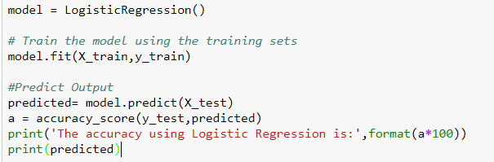
Logistic Regression - Accuracy
The accuracy using Logistic Regression is: 86%

Slide 14
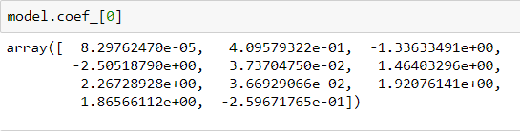

Logistic Regression – Coefficients and Intercept
Model coefficients are given in terms of log odds.
Intercept value:
Log-likelihood = -4.8354446
Notes:
It's important to point out that "the higher the log-likelihood the better" (alternatively the smaller a negative log-likelihood as is the convention for information criteria statistics like AIC and BIC)
To go back to basics, you are trying to maximize the likelihood that your model describes the data

Slide 15
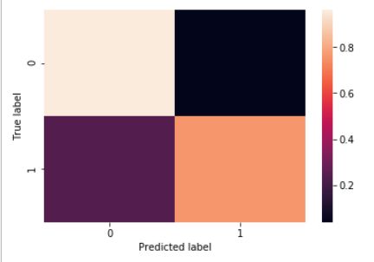
Model Evaluation – Confusion Matrix
[[24 1]
[ 6 19]]

Slide 16
Model Evaluation - Statistics
Sensitivity: True Positive Rate = TP / (TP + FN) = 24 / 30 = 0.80
Specificity: True Negative Rate = TN / (TN + FP) = 19 / 20 = 0.95
Positive Predictive Value: TP / (TP + FP) = 24 / 25 = 0.96
Negative Predictive Value: TN / (TN + FN) = 19 / 25 = 0.76
Positive Likelihood Ratio: TPR/FPR = Sensitivity / (1 – Specificity)
= 0.80/(1-0.95) = 16:1
Negative Likelihood Ratio: FNR/TNR = (1 - Sensitivity) / Specificity
= (1 – 0.80) / 0.95 = 4:19

Slide 17
Model Evaluation – Statistics
Precision is a ratio of the number of true positives divided by the sum of the true positives and false positives.
It describes how good a model is at predicting the positive class.
Recall is calculated as the ratio of the number of true positives divided by the sum of the true positives and the false negatives.
Recall is the same as sensitivity.

Slide 18
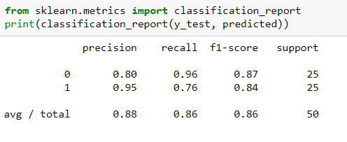
Model Evaluation - Statistics

Slide 19
Model Evaluation – ROC curve
A useful tool when predicting the probability of a binary outcome is the Receiver Operating Characteristic curve, or ROC curve.
It is a plot of the false positive rate (x-axis) versus the true positive rate (y-axis) for a number of different candidate threshold values between 0.0 and 1.0
It plots the false alarm rate versus the hit rate.
ROC curves are genrally used when there are roughly equal numbers of observations for each class.

Slide 20
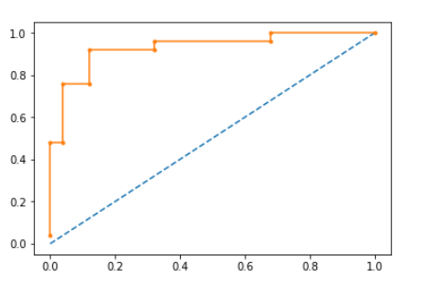
Model Evaluation – ROC curve
FPR: [ 0. 0. 0.04 0.04 0.12 0.12 0.32 0.32 0.68 0.68 1. ]
TPR: [ 0.04 0.48 0.48 0.76 0.76 0.92 0.92 0.96 0.96 1. 1. ]
Thresholds: [ 9.99885743e-01 8.81842732e-01 8.48518804e-01 6.32242509e-01
3.89330060e-01 3.19314297e-01 2.02646762e-01 2.02583371e-01
3.19046075e-02 3.00013023e-02 4.27087821e-06]

Slide 21
Future Model Improvements
This prediction model can be further improved by considering features such as:
Player of the Match (MVP)
Result of Previous Match
ICC Team Ratings
Score of openers
Number of ‘outs’ in the first 10 overs.

Slide 22
The End

